Slide 1
Handling Exceptions
Chapter 6

Slide 2
Objectives
This lesson covers the following objectives:
Describe several advantages of including exception handling code in PL/SQL
Describe the purpose of an EXCEPTION section in a PL/SQL block
Create PL/SQL code to include an EXCEPTION section
List several guidelines for exception handling

Slide 3
What is an Exception?
An exception occurs when an error is discovered during the execution of a program that disrupts the normal operation of the program
There are many possible causes of exceptions: a user makes a spelling mistake while typing; a program does not work correctly; an advertised web page does not exist; and so on
Can you think of errors that you have come across while using a web site or application?

Slide 4
What is an Exception?
Some examples of errors you may have seen:
Entering an incorrect username and/or password
Forgetting to include the @ in an email address
Entering a credit card number incorrectly
Entering an expiration date that has passed
Selecting more than one row into a single variable
Receiving “no rows returned” from a select statement

Slide 5
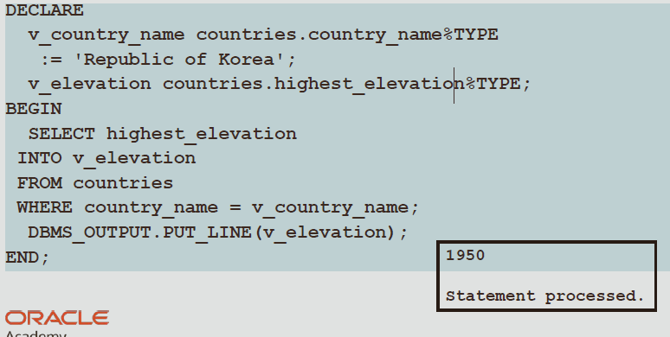
Exceptions in PL/SQL
This example works fine. But what if v_country_name was 'Korea, South' instead of 'Republic of Korea?'

Slide 6
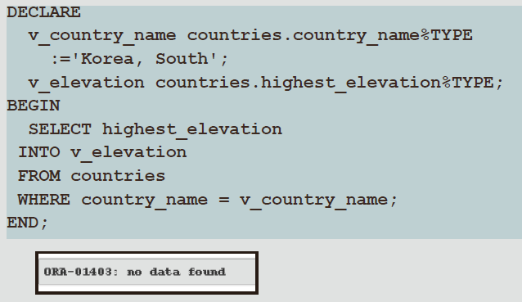
Exceptions in PL/SQL
When our v_country_name is not found, our code results in an error

Slide 7
Exceptions in PL/SQL
The code does not work as expected
No data was found for 'Korea, South' because the country name is actually stored as 'Republic of Korea'
This type of error in PL/SQL is called an exception
When code does not work as expected, PL/SQL raises an exception
When an exception occurs, we say that an exception has been "raised"
When an exception is raised, the rest of the execution section of the PL/SQL block is not executed

Slide 8
What Is an Exception Handler?
An exception handler is code that defines the recovery actions to be performed when an exception is raised (that is, when an error occurs)
When writing code, programmers need to anticipate the types of errors that can occur during the execution of that code
They need to include exception handlers in their code to address these errors
In a sense, exception handlers allow programmers to "bulletproof" their code

Slide 9
What Is an Exception Handler?
What types of errors might programmers want to account for by using an exception handler?
System errors (for example, a hard disk is full)
Data errors (for example, trying to duplicate a primary key value)
User action errors (for example, data entry error) Many other possibilities!

Slide 10
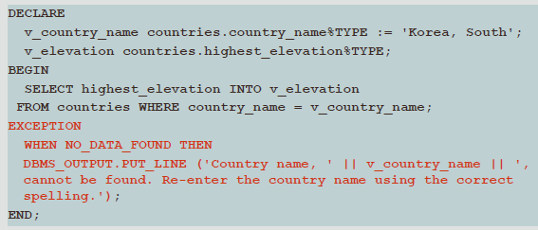
Handling Exceptions with PL/SQL
A block always terminates when PL/SQL raises an exception, but you can specify an exception handler to perform final actions before the block ends

Slide 11
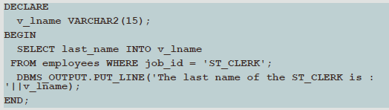
Handling Exceptions with PL/SQL
The following is another example: The select statement in the block is retrieving the last_name of Stock Clerks
However, an exception is raised because more than one ST_CLERK exists in the data

Slide 12
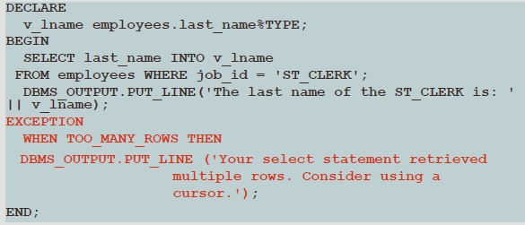
Handling Exceptions with PL/SQL

Slide 13
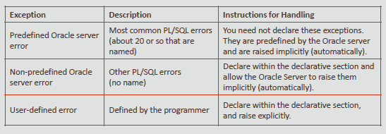
Exception Types

Slide 14
Two Types of Oracle Server Errors
Predefined Oracle server errors:
Each of these errors has a predefined name, in addition to a standard Oracle error number (ORA-#####) and message
For example, if the error ORA-01403 occurs when no rows are retrieved from the database in a SELECT statement, then PL/SQL raises the predefined exception NO_DATA_FOUND
Non-predefined Oracle server errors:
Each of these errors has a standard Oracle error number (ORA-#####) and error message, but not a predefined name
You declare your own names for these so that you can reference these names in the exception section

Slide 15
Trapping Predefined Oracle Server Errors
Reference the predefined name in the exception handling routine
Sample predefined exceptions:
NO_DATA_FOUND
TOO_MANY_ROWS
INVALID_CURSOR
ZERO_DIVIDE
DUP_VAL_ON_INDEX

Slide 16
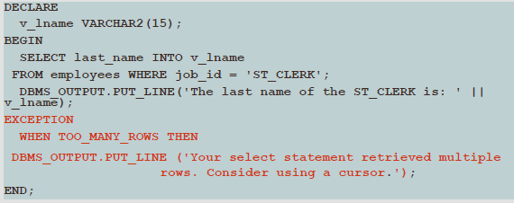
Trapping Predefined Oracle Server Errors
The following example uses the TOO_MANY_ROWS predefined Oracle server error
Note that it is not declared in the DECLARATION section

Slide 17
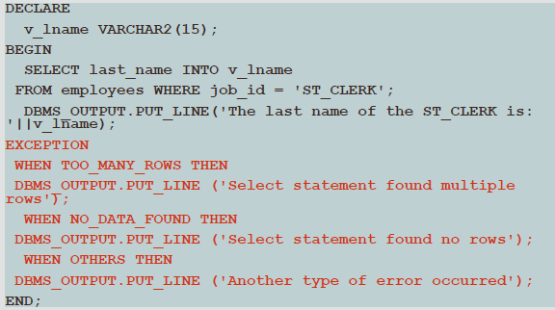
Trapping Several Predefined Oracle Server Errors

Slide 18
Trapping Non-Predefined Oracle Server Errors
Non-predefined exceptions are similar to predefined exceptions, except they do not have predefined names
They do have a standard Oracle error number (ORA-#####) and error message
To use specific handlers (rather than handling through an OTHERS clause), you create your own names for them in the DECLARE section and associate the names with the specific ORA-##### numbers using the PRAGMA EXCEPTION_INIT function
You can trap a non-predefined Oracle server error by declaring it first
The declared exception is raised implicitly
In PL/SQL, the PRAGMA EXCEPTION_INIT tells the compiler to associate an exception name with a specific Oracle error number
This allows you to refer to any Oracle Server exception by a name and to write a specific handler for it

Slide 19

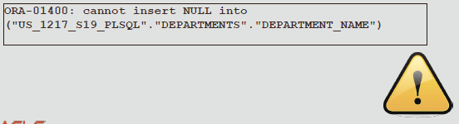
Non-Predefined Error
Examine the following example
The code above results in the error message below

Slide 20
Non-Predefined Error
The INSERT statement tries to insert the value NULL for the department_name column of the departments table
However, the operation is not successful because department_name is a NOT NULL column
There is no predefined error name for violating a NOT NULL constraint
The following slides will demonstrate how to "handle" non-predefined exceptions

Slide 21
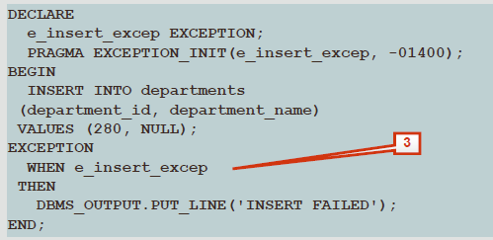
Non-Predefined Error
Declare the name of the exception in the declarative section
Associate the declared exception name with the standard Oracle server error number using the PRAGMA EXCEPTION_INIT function
Reference the declared exception name within a WHEN clause in the exception-handling section
Syntax: Exception_name Exception
PROGRAM EXCEPTION_INT (exception_name, - number)

Slide 22
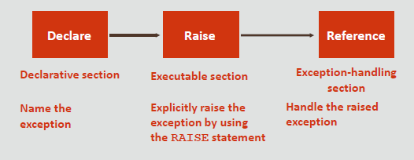
Trapping User-Defined Exceptions
PL/SQL allows you to define your own exceptions
You define exceptions depending on the requirements of your application

Slide 23
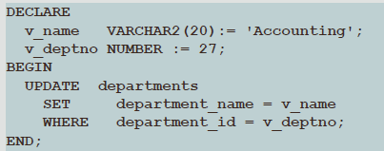
Trapping User-Defined Exceptions
One example of the need for a user-defined exception is during the input of data
Assume your program prompts the user for a department number and name so it can update the name of the department

Slide 24
Trapping User-Defined Exceptions
What happens when the user enters an invalid department?
The code as written doesn't produce an Oracle error
You need to create a user-defined error to handle this situation
You do this by:
Declaring the name of the user-defined exception within the declarative section
e_invalid_department EXCEPTION;
Using the RAISE statement to raise the exception explicitly within the executable section
IF SQL%NOTFOUND THEN RAISE e_invalid_department;9

Slide 25

Referencing the declared exception name within a WHEN clause in the exception-handling section
These three "steps" are similar to what we did in the previous lesson with non-predefined Oracle errors
The differences are, no PRAGMA EXCEPTION_INIT is required and you must explicitly raise the exception using the RAISE command

Slide 26
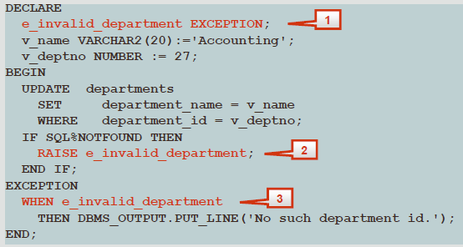
Trapping User-Defined Exceptions
The completed code with the "steps" indicated

Slide 27
The RAISE_APPLICATION_ERROR Procedure
You can use the RAISE_APPLICATION_ERROR procedure to return user-defined error messages from stored subprograms
The following slides explain the syntax for using RAISE_APPLICATION_ERROR
The main advantage of using this procedure instead of RAISE, is that RAISE_APPLICATION_ERROR allows you to associate your own error number and meaningful message with the exception

Slide 28

The RAISE_APPLICATION_ERROR Syntax
The error_number must fall between -20000and-20999
This range is reserved by Oracle for programmer use, and is never used for predefined Oracle server errors
message is the user-specified message for the exception
It is a character string up to 2,048 bytes long

Slide 29
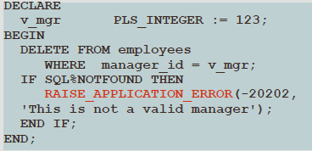
RAISE_APPLICATION_ERROR in the Executable Section
When called, the RAISE_APPLICATION_ERROR procedure displays the error number and message to the user
This process is consistent with other Oracle server errors

Slide 30
Questions

